Slide 1
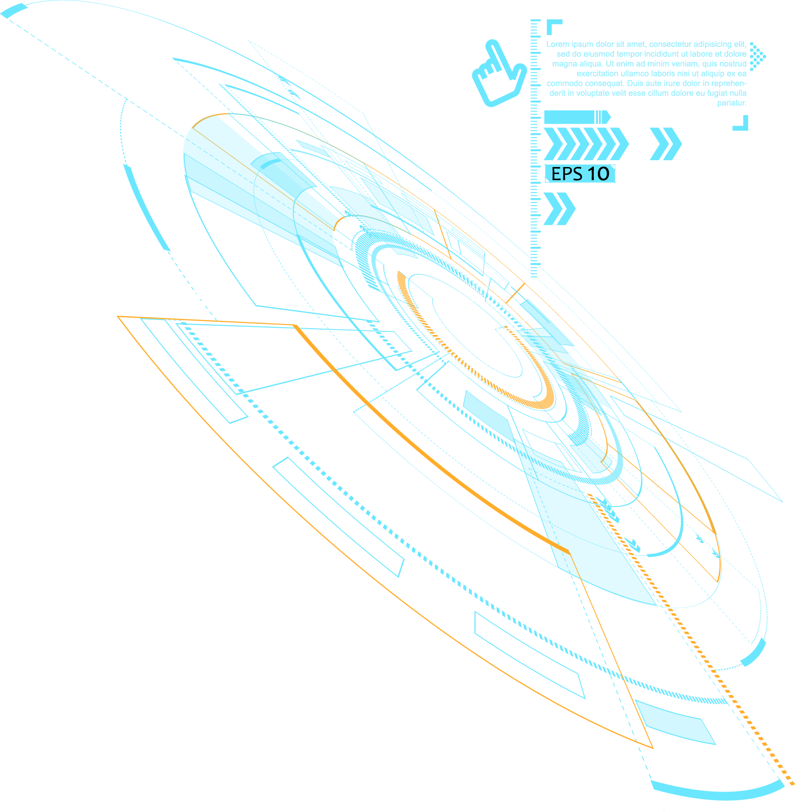

2022
WebGL常用API总结
讲解人：冰

Slide 2
前 言
帕累托法则
帕累托法则（英语：Pareto principle，也被称为 80/20 法则、关键少数法则、二八法则），是罗马尼亚管理学家约瑟夫·朱兰提出的一条管理学原理。该法则以意大利经济学家维尔弗雷多·帕累托的名字命名。帕累托于1906年提出了著名的关于意大利社会财富分配的研究结论：20％的人口掌握了80％的社会财富。这个结论对大多数国家的社会财富分配情况都成立。因此，该法则又被称为80/20法则。
朱兰博士在管理学中采纳了该思想，认为在任何情况下，事物的主要结果只取决于一小部分因素。这个思想经常被应用到不同的领域，经过大量的试验检验后，被证明其在大部分情况下，都是正确的。所以，该法则对于指导开展管理活动非常有帮助。

Slide 3
目录 / Contents
01
WebGL初始化相关方法
02
着色器相关方法
03
04
绘制相关方法
缓冲区相关方法

Slide 4
01
WebGL初始化相关方法

Slide 5
WebGL容器获取
获取WebGL上下文 c.getContext('experimental-webgl');
WebGL平面可视区域设置
void gl.viewport(x, y, width, height);

Slide 6
02
着色器相关方法

Slide 7
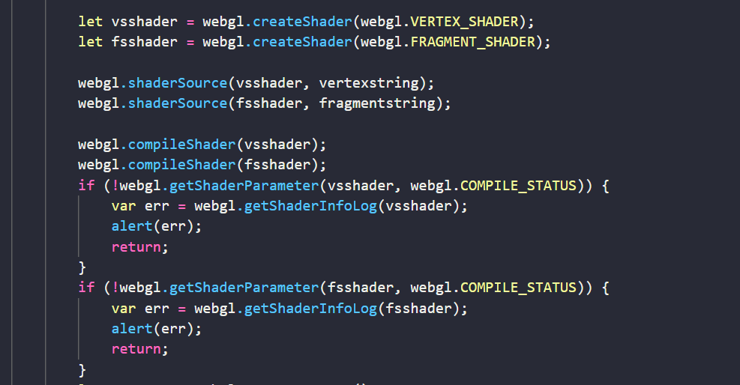
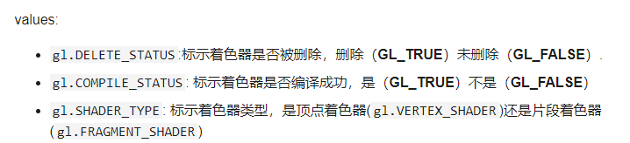
WebGLShader gl.createShader(type);
参数为gl.VERTEX_SHADER 或 gl.FRAGMENT_SHADER两者中的一个。
void gl.shaderSource(shader, source);
shader
用于设置程序代码的 WebGLShader （着色器对象）。
source
包含GLSL程序代码的字符串。
着
色
器
编
译
验证GLSL字符串是否有问题

Slide 8
03
缓冲区相关方法

Slide 9
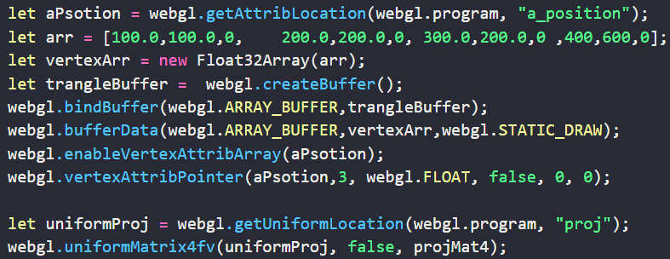
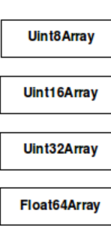
获取GLSL里面的变量
getAttribLocation
getUniformLocation
创建JavaScript数组
通常WebGL中的浮点数都是Float32，Ieee单精度模型。 Float64在图形学中目前应用比较少。
void gl.vertexAttribPointer(index, size, type, normalized, stride, offset);

Slide 10
03
绘制相关方法

Slide 11
// 缓冲区类型
// 为 gl.clear 的参数
const GLenum DEPTH_BUFFER_BIT = 0x00000100;
const GLenum STENCIL_BUFFER_BIT = 0x00000400;
const GLenum COLOR_BUFFER_BIT = 0x00004000;
// 清理指定缓存内容, 可以通过或运算符一次清理多个缓冲区
// @param mask 颜色缓冲区（COLOR_BUFFER_BIT） | 深度缓冲区（DEPTH_BUFFER_BIT） | 模板缓冲区（STENCIL_BUFFER_BIT）
void clear(GLbitfield mask);
// 将指定缓冲区设置为指定的值（参数范围都是 0.0 - 1.0）
// clearColor 指定的值 默认 0.0, 0.0, 0.0, 0.0
// clearDepth 指定的值 默认 1.0
// clearStencil 指定的值 默认 0
void clearColor(GLclampf red, GLclampf green, GLclampf blue, GLclampf alpha);
void clearDepth(GLclampf depth);
void clearStencil(GLint s);
// 绘制的类型
// 为 gl.drawArrays、gl.drawElements 第一个参数
const GLenum POINTS = 0x0000;
const GLenum LINES = 0x0001;
const GLenum LINE_LOOP = 0x0002;
const GLenum LINE_STRIP = 0x0003;
const GLenum TRIANGLES = 0x0004;
const GLenum TRIANGLE_STRIP = 0x0005;
const GLenum TRIANGLE_FAN = 0x0006;
// 执行绘制， 按照mode参数指定的方式绘制图形
// @param model 绘制模式。
// @param first 指定从哪个定点开始绘制
// @param count 指定绘制需要用到多少个顶点
void drawArrays(GLenum mode, GLint first, GLsizei count);
// 执行绘制，按照mode参数制定的方式，根据绑定到 ELEMENT_ARRAY_BUFFER 的缓冲区中的顶点索引绘制图形
// @param model 绘制模式。
// @param count 指定绘制顶点的个数
// @param type 指定索引值数据类型。包括：UNSIGNED_BYTE、UNSIGNED_SHORT、UNSIGNED_INT
// @param offset 指定索引数组中绘制的偏移位置，以字节为单位
void drawElements(GLenum mode, GLsizei count, GLenum type, GLintptr offset);

Slide 12
1
单击此处输入标题 / Click here to add your title
输入标题
输入标题
输入标题
When a cigarette falls in love with a match,it is destined to be hurt.
When a cigarette falls in love with a match,it is destined to be hurt.
When a cigarette falls in love with a match,it is destined to be hurt.
单击此处输入标题文本
I love you more than I've ever loved any woman. And I've waited longer for you than I've waited for any woman.I love you more than I've ever loved any woman. And I've waited longer for you than I've waited for any woman.

Slide 13
1
单击此处输入标题 / Click here to add your title
85%
73%
78%
90%
单击此处输入标题
I love you more than I've ever loved any woman. And I've waited longer for you than I've waited for any woman.
单击此处输入标题
I love you more than I've ever loved any woman. And I've waited longer for you than I've waited for any woman.
单击此处输入标题
I love you more than I've ever loved any woman. And I've waited longer for you than I've waited for any woman.
单击此处输入标题
I love you more than I've ever loved any woman. And I've waited longer for you than I've waited for any woman.

Slide 14

1
单击此处输入标题 / Click here to add your title
单击此处输入标题
I love you more than I've ever loved any woman. And I've waited longer for you than I've waited for any woman.
I love you more than I've ever loved any woman. And I've waited longer for you than I've waited for any woman.
I love you more than I've ever loved any woman. And I've waited longer for you than I've waited for any woman.I love you more than I've ever loved any woman. And I've waited longer for you than I've waited for any woman.

Slide 15
1
单击此处输入标题 / Click here to add your title
单击此处输入标题
单击此处输入标题
I love you more than I've ever loved any woman. And I've waited longer for you than I've waited for any woman.
I love you more than I've ever loved any woman. And I've waited longer for you than I've waited for any woman.
单击此处输入标题
单击此处输入标题
I love you more than I've ever loved any woman. And I've waited longer for you than I've waited for any woman.
I love you more than I've ever loved any woman. And I've waited longer for you than I've waited for any woman.

Slide 16
1
单击此处输入标题 / Click here to add your title
单击此处输入标题
单击此处输入标题
I love you more than I've ever loved any woman. And I've waited longer for you than I've waited for any woman.
单击此处输入标题
I love you more than I've ever loved any woman. And I've waited longer for you than I've waited for any woman.
单击此处输入标题
I love you more than I've ever loved any woman. And I've waited longer for you than I've waited for any woman.

Slide 17
1
单击此处输入标题 / Click here to add your title
单击此处输入标题
单击此处输入标题
单击此处输入标题
单击此处输入标题
I love you more than I've ever loved any woman. And I've waited longer for you than I've waited for any woman.I love you more than I've ever loved any woman. And I've waited longer for you than I've waited for any woman.

Slide 18
1
单击此处输入标题 / Click here to add your title
单击此处输入标题
I love you more than I've ever loved any woman. And I've waited longer for you than I've waited for any woman.
单击此处输入标题
I love you more than I've ever loved any woman. And I've waited longer for you than I've waited for any woman.
单击此处输入标题
I love you more than I've ever loved any woman. And I've waited longer for you than I've waited for any woman.
单击此处输入标题
I love you more than I've ever loved any woman. And I've waited longer for you than I've waited for any woman.

Slide 19
04
单击此处输入标题文本
Remember what should be remembered, and forget what should be forgotten.Remember what should be remembered, and forget what should be forgotten.

Slide 20



1
单击此处输入标题 / Click here to add your title
单击此处输入标题
单击此处输入标题
I love you more than I've ever loved any woman. And I've waited longer for you than I've waited for any woman.
单击此处输入标题
I love you more than I've ever loved any woman. And I've waited longer for you than I've waited for any woman.
单击此处输入标题
I love you more than I've ever loved any woman. And I've waited longer for you than I've waited for any woman.

Slide 21
1
单击此处输入标题 / Click here to add your title
单击此处输入标题
I love you more than I've ever loved any woman. And I've waited longer for you than I've waited for any woman.
单击此处输入标题
I love you more than I've ever loved any woman. And I've waited longer for you than I've waited for any woman.
单击此处输入标题
I love you more than I've ever loved any woman. And I've waited longer for you than I've waited for any woman.

Slide 22

1
单击此处输入标题 / Click here to add your title
单击此处输入标题
I love you more than I've ever loved any woman. And I've waited longer for you than I've waited for any woman.
单击此处输入标题
I love you more than I've ever loved any woman. And I've waited longer for you than I've waited for any woman.
单击此处输入标题
I love you more than I've ever loved any woman. And I've waited longer for you than I've waited for any woman.

Slide 23
1
单击此处输入标题 / Click here to add your title
单击此处输入标题
I love you more than I've ever loved any woman. And I've waited longer for you than I've waited for any woman.
单击此处输入标题
I love you more than I've ever loved any woman. And I've waited longer for you than I've waited for any woman.
单击此处输入标题
I love you more than I've ever loved any woman. And I've waited longer for you than I've waited for any woman.

Slide 24

THANK YOU
微信功能号
同名Bilibili\csdn

